Slide 1
Dimensionality Reduction
Dr. Muhammad Nouman Durrani

Slide 2
List of associated tutorials and Chapters to Lecture 4
CHAPTER 11. DIMENSIONALITY REDUCTION Page 405-424
Singular Value Decomposition (SVD): A Fast Track Tutorial
for SVD Matrices (U, Σ and V^{T} calculations of a 2x2 Matrix M)
Singular Value Decomposition Tutorial
for Matrices related concepts, Eigen Values, Eigen Vectors, and SVD (3x3) matrix
Finding eigenvalues and eigenvectors
for 3x3 matrix. Here row echelon form for calculating Eigen Vectors has also covered

Slide 3
Dimensionality reduction
A matrix can be summarized by finding “narrower” matrices that in some sense close to the original matrix
These narrow matrices have only a small number of rows or columns, but can be used much more efficiently than the original large matrix
The process of finding these narrow matrices is called dimensionality reduction

Slide 4
Principal-component analysis (PCA)
Principal-component analysis (PCA) is a technique for taking a dataset consisting of a set of tuples representing points in a high-dimensional space and finding the directions along which the tuples line up best
The idea is to treat the set of tuples as a matrix M and find the eigenvectors for MM^{T}
The matrix of these eigenvectors can be thought of as a rigid rotation in a high-dimensional space
When you apply this transformation to the original data, the axis corresponding to the principal eigenvector is the one along which the points are most “spread out”

Slide 5
Principal-component analysis (PCA)
On this axes, the variance of the data is maximized.
The points can best be viewed as lying along this axis, with small deviations from this axis.
Likewise, the axis corresponding to the second eigenvector (the eigenvector corresponding to the second-largest eigenvalue) is the axis along which the variance of distances from the first axis is greatest, and so on.

Slide 6
Principal-component analysis (PCA)
The high-dimensional data can be replaced by its projection onto the most important axes.
These axes are the ones corresponding to the largest eigenvalues.
Thus, the original data is approximated by data that has many fewer dimensions and that summarizes well the original data.

Slide 7
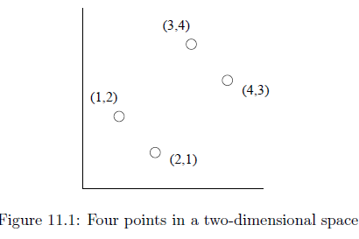
An Illustrative Example
The data is two-dimensional, a number of dimensions that is too small to make PCA really useful.
Moreover, the data, shown in Fig. 11.1 has only four points, and they are arranged in a simple pattern along the 45-degree line to make our calculations easy to follow.
The points can best be viewed as lying along the axis that is at a 45-degree angle, with small deviations in the perpendicular direction.

Slide 8
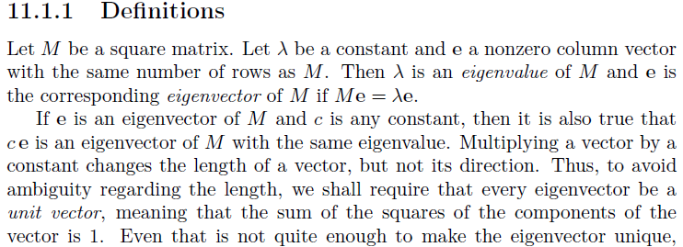
Eigenvalue and Eigenvector
Every

Slide 9
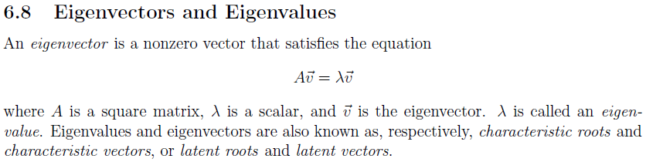
We can find eigenvalues and eigenvectors by treating a matrix as a system of linear equations, and
Solving for the values of the variables that make up the components of the eigenvector

Slide 10
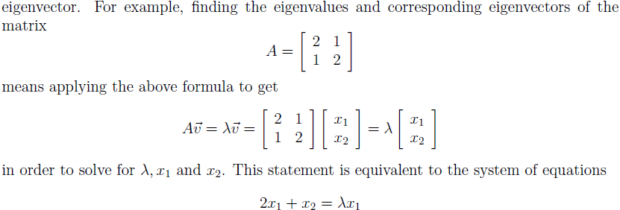
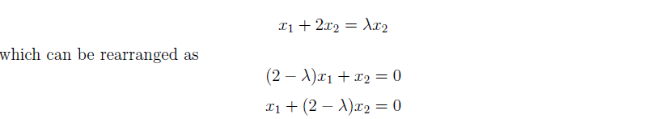

Slide 11
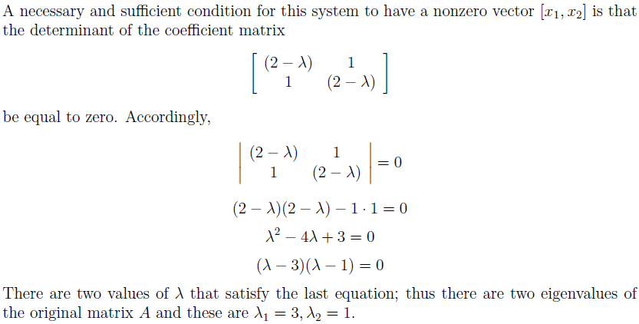

Slide 12
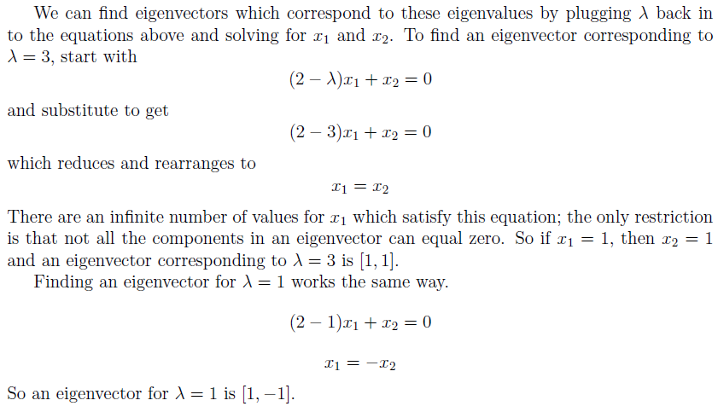

Slide 13

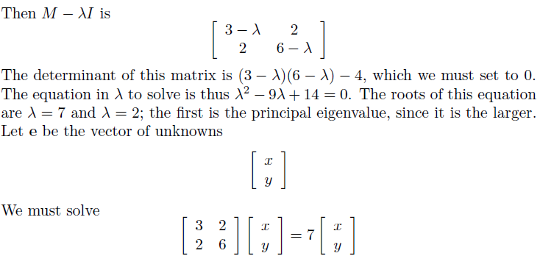

Slide 14
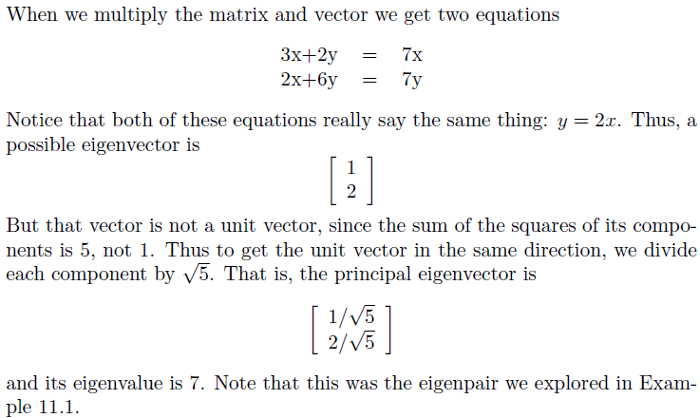

Slide 15
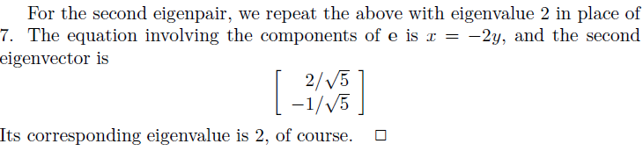

Slide 16
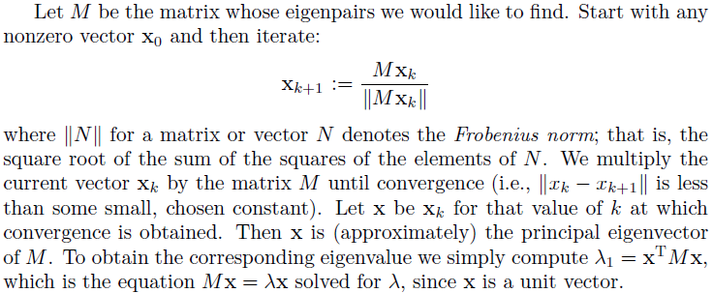
Finding Eigenpairs by Power Iteration

Slide 17
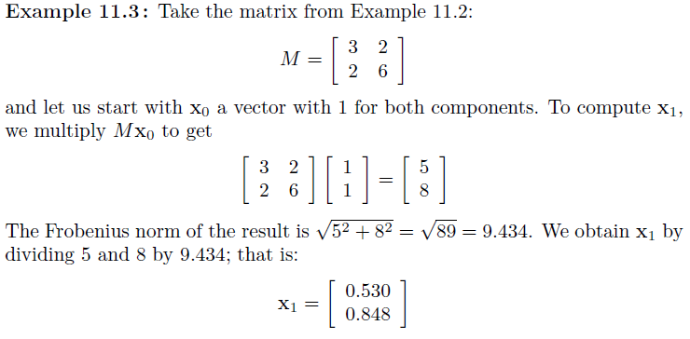

Slide 18
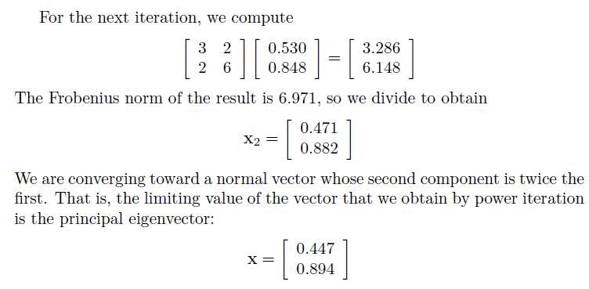
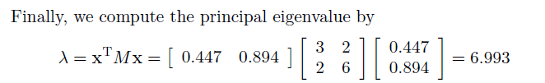
The true principal eigenvalue is 7.
Power iteration will introduce small errors due either to limited precision, as was the case here.
Or due to the fact that we stop the iteration before reaching the exact value of the eigenvector.

Slide 19
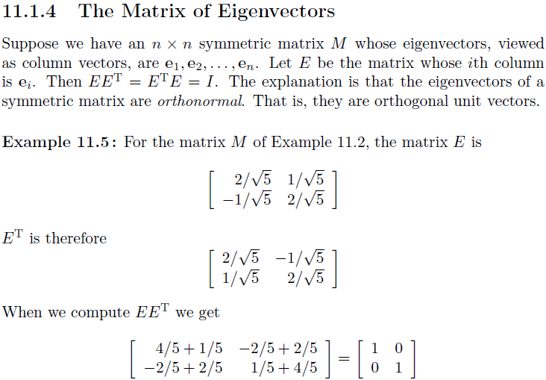

Slide 20
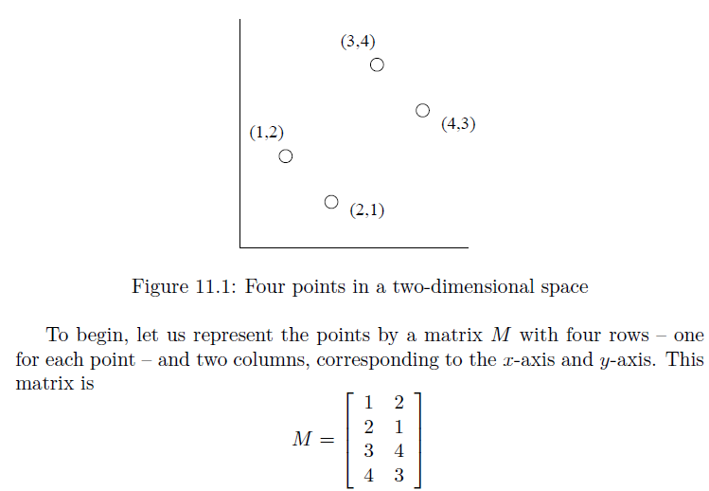

Slide 21
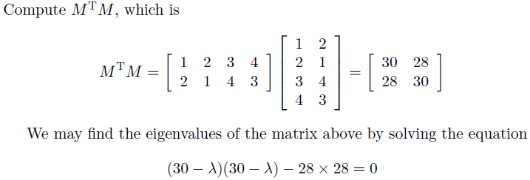
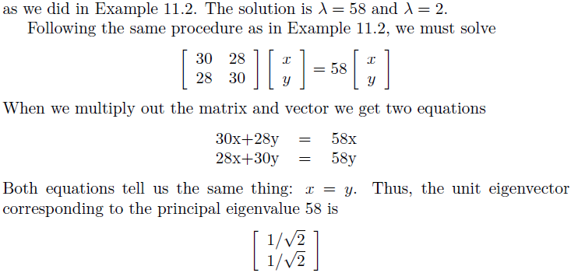

Slide 22
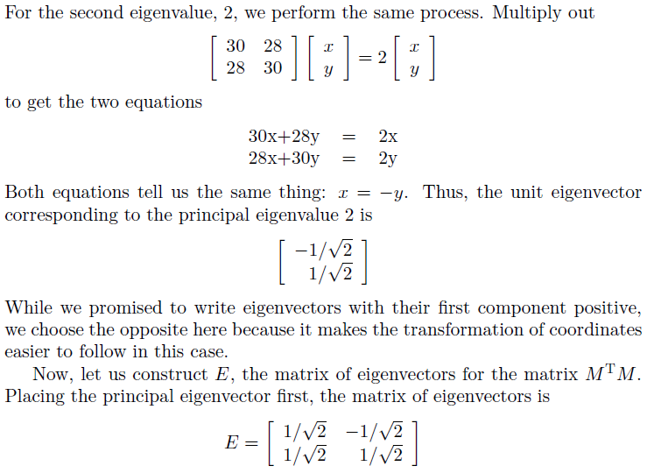

Slide 23
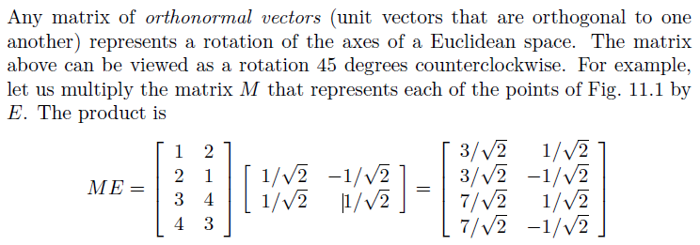

Slide 24
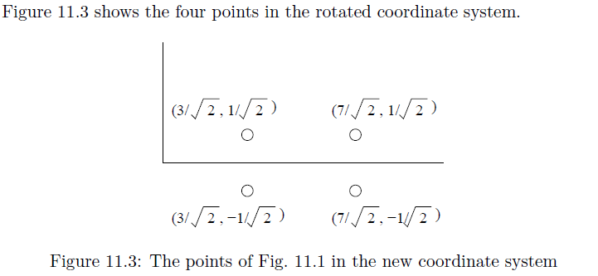

Slide 25
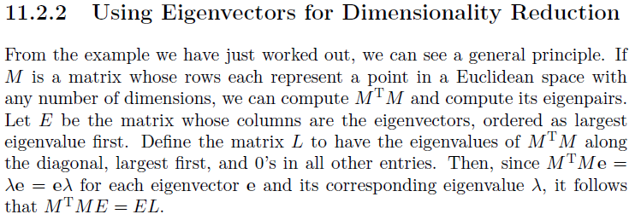

Slide 26
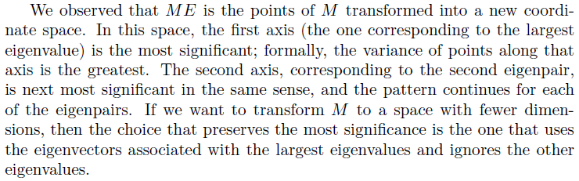

Slide 27
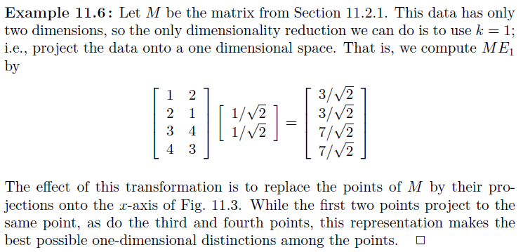

Slide 28
Singular Value Decomposition (SVD)
SVD can be looked at from three mutually compatible points of view.
We can see it as a method for transforming correlated variables into a set of uncorrelated ones that better expose the various relationships among the original data items.
At the same time, SVD is a method for identifying and ordering the dimensions along which data points exhibit the most variation.
Once we have identified where the most variation is, it's possible to find the best approximation of the original data points using fewer dimensions.
Hence, SVD can be seen as a method for data reduction.

Slide 29
Singular Value Decomposition (SVD)
Singular value decomposition (SVD), allows an exact representation of any matrix, and also makes it easy to eliminate the less important parts of that representation to produce an approximate representation with any desired number of dimensions
Of course the fewer the dimensions we choose, the less accurate will be the approximation

Slide 30
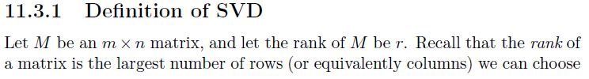
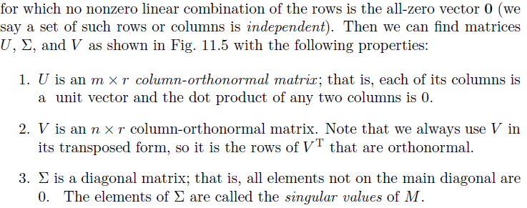
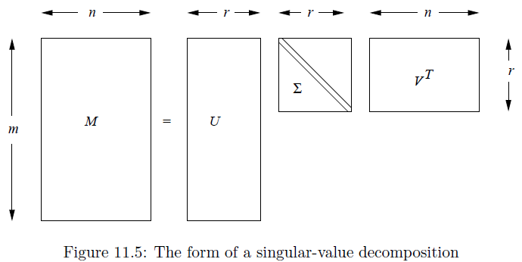

Slide 32
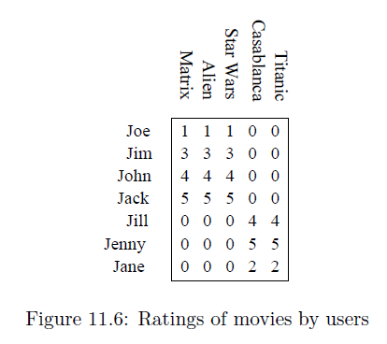
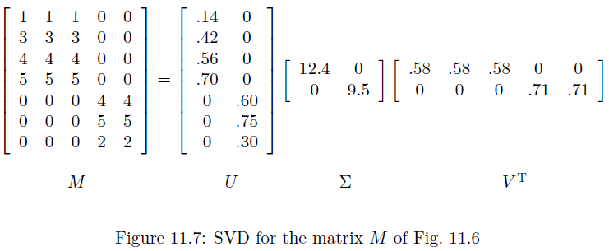

Slide 33
Interpretation of SVD
SVD offers is in viewing the r columns of U, Σ, and V as representing concepts that are hidden in the original matrix M
In Figure 11.6, these concepts are clear; one is “science fiction” and the other is “romance”
Let us think of the rows of M as people and the columns of M as movies
Matrix U connects people to concepts
The matrix V relates movies to concepts
The matrix Σ gives the strength of each of the concepts.
In our example, the strength of the science-fiction concept is 12.4, while the strengthof the romance concept is 9.5.

Slide 34
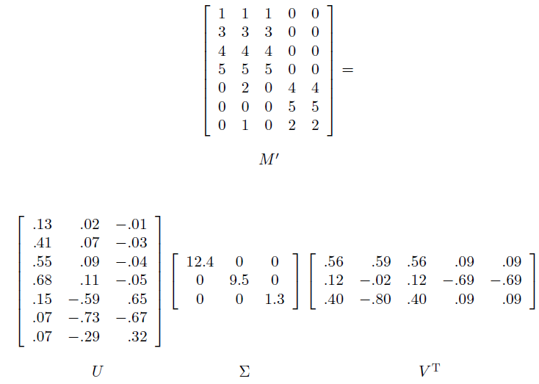
How U, Σ and V^{T} are calculated, please see SVD tutorial 1 and 2 in my uploaded files at slate.

Slide 35
Dimensionality Reduction Using SVD
Suppose we want to represent a very large matrix M by its SVD components U, Σ, and V , but these matrices are also too large to store conveniently
The best way to reduce the dimensionality of the three matrices is to set the smallest of the singular values to zero
If we set the s smallest singular values to 0, then we can also eliminate the corresponding s columns of U and V .
Set the smallest of the singular values, which is 1.3, to zero in Example 11.9, the effect is:
the third column of U and the third row of V ^{T} are multiplied only by 0’s and the U’s row and V ^{T}’s column may be eliminated, as shown in Fig. 11.10.

Slide 36
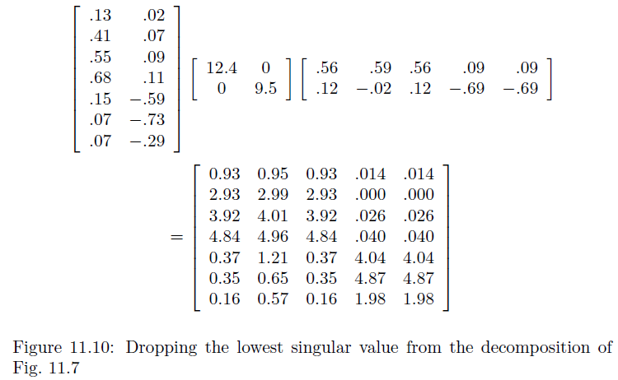

Slide 37
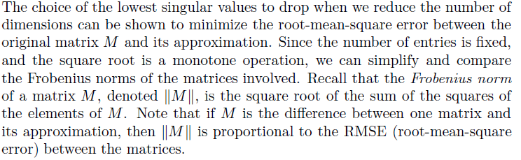
Why Zeroing Low Singular Values Works

Slide 38
